Slide 1

Turn your plain text into a polished, user-friendly documentation portal!
MKDocs
by Ravisankar Pandian

Slide 2


Topics covered
What is MKDocs?
Why should you care?
How does it work?
How to install it in IBM-i Server?
Some good use cases
What is Markdown?
What is YAML?
Conclusion
Programmers.io Confidential and Proprietary

Slide 3


Objectives
Take away from the session:
Good understating of MKDocs and it’s installation.
Differences between MKDocs & Other Wiki/Document portal.
Best practices for using MKDocs in an efficient way.
Session is Useful for:
Developer team (especially IBMi)
Documentation team
Project Management team
Programmers.io Confidential and Proprietary

Slide 4

What is MKDocs?
MKDocs is a static site generator specifically designed for building project documentation.
It takes your Markdown files (which are easy to write) and transforms them into a nice-looking website.
Imagine it as a magic wand that turns your plain text into a polished, user-friendly documentation portal.
Programmers.io Confidential and Proprietary

Slide 5
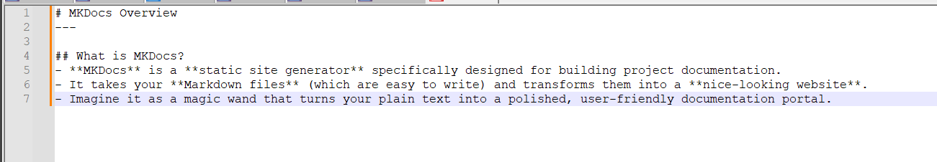
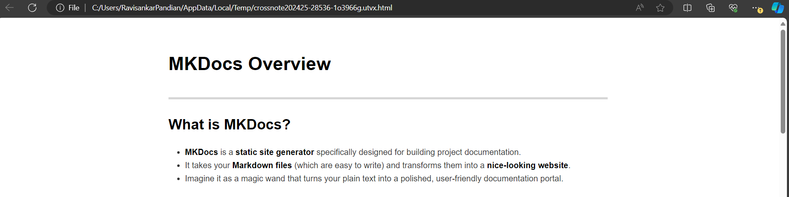
Why should you care?
Simplicity: MKDocs keeps things straightforward. You write your documentation in Markdown, and it handles the rest.
Programmers.io Confidential and Proprietary

Slide 6
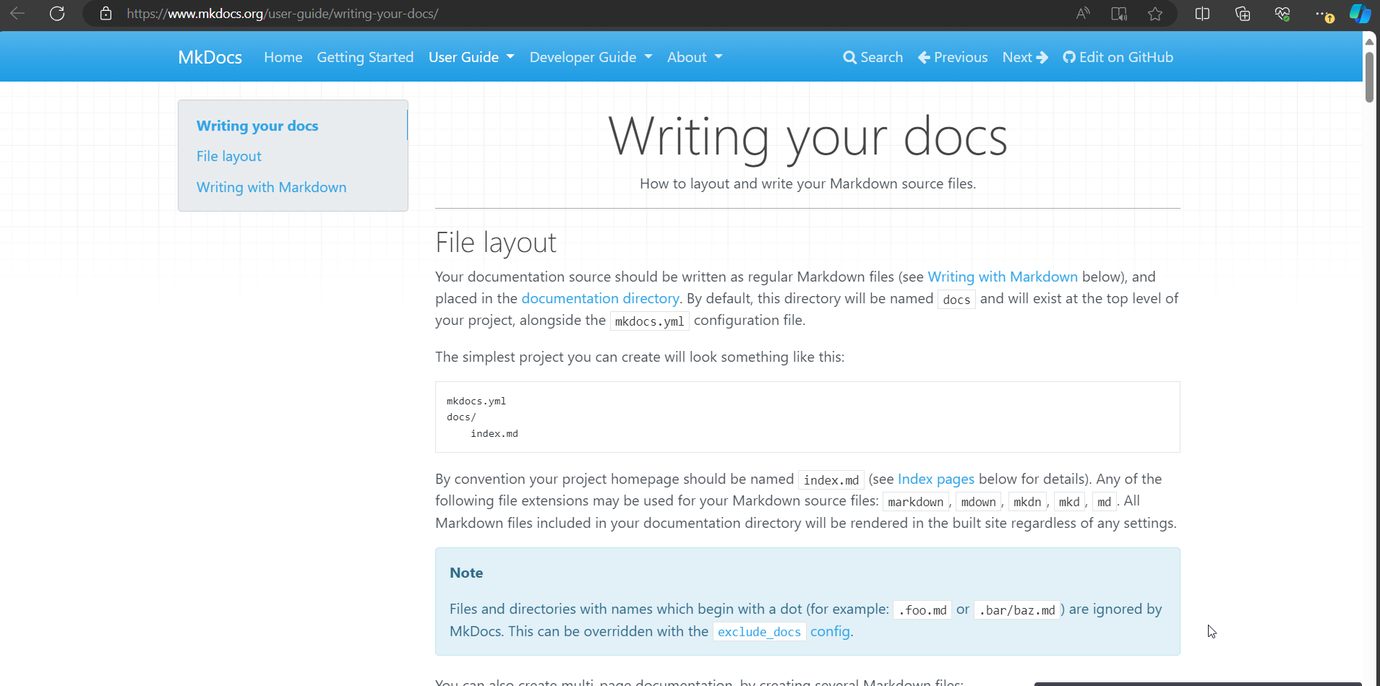
Why should you care?
Modern Look & Live preview: It generates sleek, modern web pages that users will love.
Just like designing a WordPress or WIX website, we can live preview the design on the go.
Programmers.io Confidential and Proprietary

Slide 7

Why should you care?
No Database/Web Server: No database required. And technically no web server either since the build option creates a static, standalone HTML site.
Even better, you can live preview the website as you create which will be hosted on your local host and be done with it.
Programmers.io Confidential and Proprietary

Slide 8
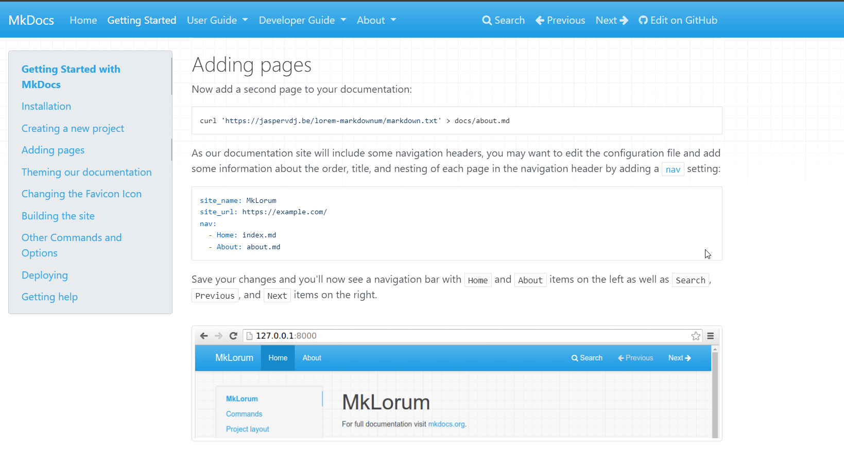
Why should you care?
Material Theme: It uses the Material for MkDocs theme, which makes your documentation look good without any extra effort. This theme is used by popular projects like Typer CLI and FastAPI.
Programmers.io Confidential and Proprietary

Slide 9
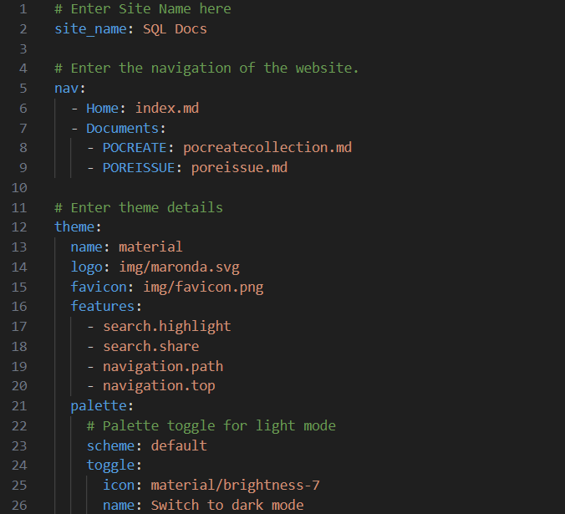

Why should you care?
YAML Configuration: YAML stands for “YAML Ain’t Markup Language”. It’s a human-readable data serialization standard, which is used here to specify settings like the site name, navigation structure, and theme. A sample YAML config file is below.
Programmers.io Confidential and Proprietary

Slide 10



How does it work?
Your documentation website is ready within minutes!
Install MKDocs in 3 easy steps
Start writing the Document in Markdown format
Programmers.io Confidential and Proprietary

Slide 11


How to install it in IBM-I Server
Pre-Requisites:
IBM i Version 7.3 and above
Open-Source Package Management System
Python3 need to be installed
Installation:
Create Python Virtual Env (optional)
Install MKDocs via pip
Create a new project and start designing your
documentation website
Programmers.io Confidential and Proprietary

Slide 12
How to install it in IBM-I Server
Detailed install steps
Set PATH variable to locate Open-Source packages
Install gcc and python3, and developer packages using the following commands from bash
Once python is installed, run the below commands one by one. Read the #comments to understand what these commands do.
PATH=/QOpenSys/pkgs/bin:/QOpenSys/usr/bin:/usr/ccs/bin:/QOpenSys/usr/bin/X11:/usr/sbin:.:/usr/bin
yum install gcc* python3* python3-devel
mkdir mydoc && cd mydoc #------------------------------------> Create a new folder called mydoc and navigate to it python3 -m venv pyfiles #-----------------------------------------> Create a new Virtual Environment called pyfiles source pyfiles/bin/activate #------------------------------------> Activate the python Virtual Environment pyfiles pip3 install mkdocs #-------------------------------------------------> Install MKDocs mkdocs new docproject #----------------------------------------> Create a new MKDocs project called 'docproject'. A new folder named 'docproject' will be available. pip install mkdocs-material #-----------------------------------> Install Material theme for the website mkdocs serve --dev-addr=129.40.95.65:8558 #---> Serve a live website on the server's IP address with the port# 8558
Programmers.io Confidential and Proprietary

Slide 13
Some good use cases
Internal Documentation Portal
MKDocs is perfect for creating an internal documentation portal within any organization. Use it to document,
Project guidelines, best practices, and coding standards.
System configurations, setup instructions, and troubleshooting guides.
API documentation, including endpoints, parameters, and examples.
Knowledge base for devs, sysadmins and support teams.
Document common issues, including FAQs and solutions by specifying code snippets and step by step instructions.
Programmers.io Confidential and Proprietary

Slide 14
Some good use cases
Collaborative Documentation Efforts
MKDocs allows multiple contributors to work on the same documentation.
Review, edit, and improve documentation collectively.
Use Git or other version control systems to collaborate. Since MKDocs's documentation are stored in IFS, it is easier to integrate with Git.
Programmers.io Confidential and Proprietary

Slide 15
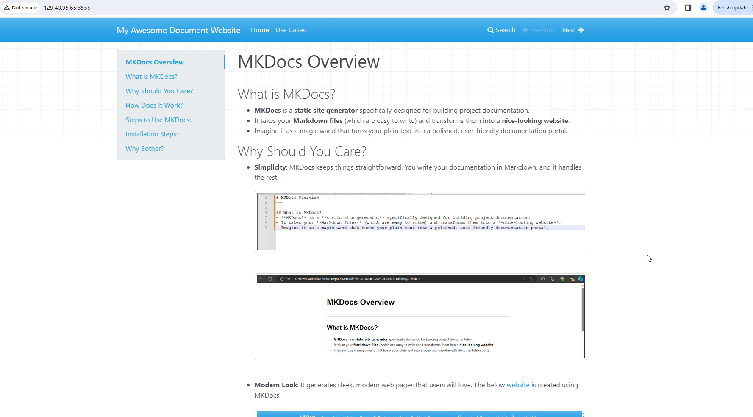
Demo
Programmers.io Confidential and Proprietary

Slide 16
Questions and Answers
Thank you

